Slide 1

Building Renovation Efforts for Zero Emission Buildings
Co-funded by the European Union. Views and opinions expressed are however those of the author(s) only and do not necessarily reflect those of the European Union or CINEA . Neither the European Union nor the granting authority can be held responsible for them.

Slide 2

Project details
LIFE-2024-CET
Towards an effective implementation of key legislation in the field of sustainable energy
Scope C: Support for the implementation of the Energy Performance of Buildings Directive
Duration: 01 September 2025 – 31 August 2028

Slide 3
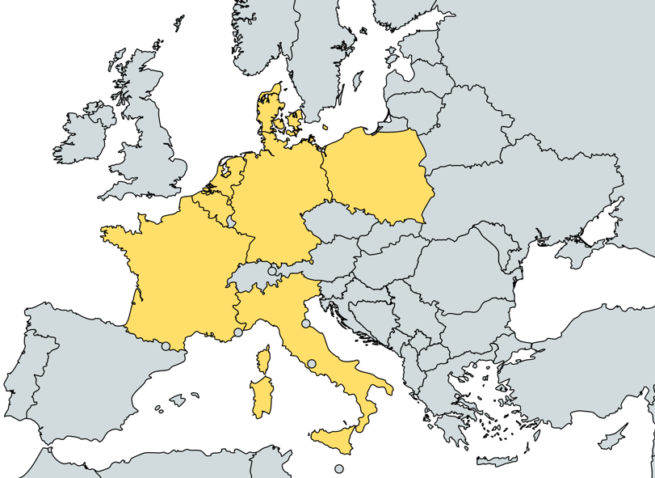
Partners
BREEZE takes a strong interdisciplinary approach, bringing together 8 partners from 7 countries across Europe.

Slide 4








Partners
WIP Renewable Energies (Germany)
EURAC Research (Italy)
SolarPower Europe (Belgium)
CSTB - Centre Scientifique et Technique du Bâtiment (France)
NAPE - National Energy Conservation Agency (Poland)
ENEA - Italian National Agency for New Technologies, Energy and Sustainable Economic Development (Italy)
EPB Center - Energy Performance of Buildings Standarts (Netherlands)
DTU – Technical University of Denmark (Denmark)

Slide 5



Overall Objectives
Gather and harmonize building stock data from Poland, Italy, and France.
Develop open software tools for cost-optimal renovation calculations and scenario planning.
Identify representative reference buildings and apply cost-optimal renovation methods, extrapolating results to other Member States.

Slide 6




Overall Objectives
Align with the EPBD* Recast, ensuring renovations improve energy efficiency and comply with IEQ** standards.
Integrate Solar Mandates by assessing the potential for solar PV deployment in renovations.
Provide standardized methodologies for energy performance certification, smart readiness, and IEQ metrics.
Implement capacity-building and technical assistance activities.
*Energy Performance of Buildings Directive
**Indoor Environmental Quality

Slide 7
Specific Objectives
Wider adoption of harmonized calculation methodologies for evidence-based policy making
Help Member States move from national EPC standards to international one.
Provide an open-source software tool for cost-optimal renovation calculations, scenario analysis, and policy support.
Enable policymakers to assess impacts of harmonized EPC methodologies, minimum energy performance levels, IEQ, and renewable integration.

Slide 8
Outcomes
3 open datasets
1 updated calculation methodology
1 guideline set with use cases
Open-source software library

Slide 9
Development of a coherent and EU-wide approach to practically improve IEQ
Develop a standardized IEQ rating scheme (base & extended parameter lists) to compare building performance across Member States.
Integrate health and comfort factors (air quality, thermal comfort, occupant well-being) into renovation strategies, in line with the 2024 EPBD Recast.
Deliver methodologies for prediction and monitoring of IEQ during both design and operation phases.

Slide 10
Outcomes
New IEQ performance metric & rating scheme
Tested protocols for design-stage prediction and operation-stage monitoring
Methodology including occupant feedback
Parameters ready for integration into EU databases

Slide 11
Solar Mandate implementation at national level and PV systems integration into building renovations
Overcome barriers to Solar Mandate implementation at national level.
Develop best practice guidelines for integrating PV and BIPV in building renovations.
Showcase studies demonstrating renovation & solar deployment, tailored to building type, location, and energy needs.
Create cost-optimal renovation scenarios to support EPBD compliance and inform national implementation plans.

Slide 12
Outcomes
Guidelines for Solar Mandate implementation and PV/BIPV integration
Case studies on renovation with PV solutions

Slide 13
Development of renovation roadmaps tailored to different residential building categories, including cost-benefit analysis
Develop renovation scenarios tailored to building categories, based on pilot country data.
Identify cost-effective decarbonisation pathways to meet EPBD recast targets.
Provide guidance on financial resources, energy savings, GHG reduction, and energy poverty alleviation.
Deliver a replicable renovation scenario planner and guidelines for policymakers to estimate EPBD impact.

Slide 14
Outcomes
Renovation roadmaps & scenarios for pilot countries
Renovation scenario planner + guidelines

Slide 15
Policy implementation and monitoring
Support Member States in implementing and enforcing EPBD Recast policies consistently across regions.
Develop coherent methodologies, monitoring tools, and provide technical assistance to authorities.
Collect and harmonize data from EPCs, Smart Readiness Indicators, Renovation Passports, and metered consumption to evaluate policy impact.
Provide training, guidelines, and good practices to improve enforcement and compliance.

Slide 16
Outcomes
Coherent policy implementation methodologies
Training programs for national/regional authorities
Regular assessments and reports evaluating policy effectiveness100 datasets from pilot countries

Slide 17
Impact
BREEZE accelerates the shift toward zero-emission buildings by improving data quality, supporting smart renovation decisions, and strengthening national and local capacities.
The project contributes directly to achieving EU climate-neutrality and renewable energy targets.

Slide 18
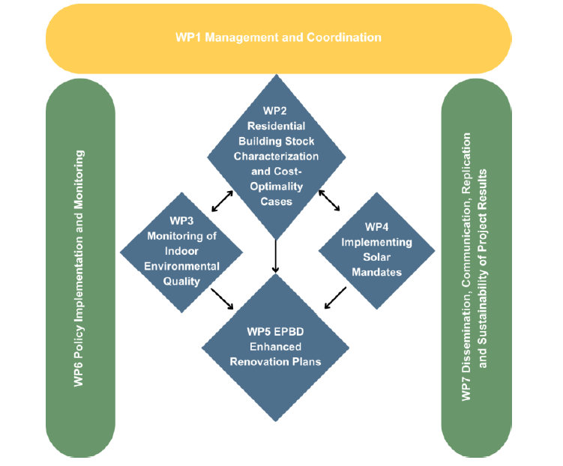

Slide 19





Contact
Partners
Duygu Celik
duygu.celik@wip-munich-de
Johannes Stierstorfer
johannes.stierstorfer@wip-munich-de
WIP Renewable Energies

